Slide 1
Floorplanning-1

Slide 2
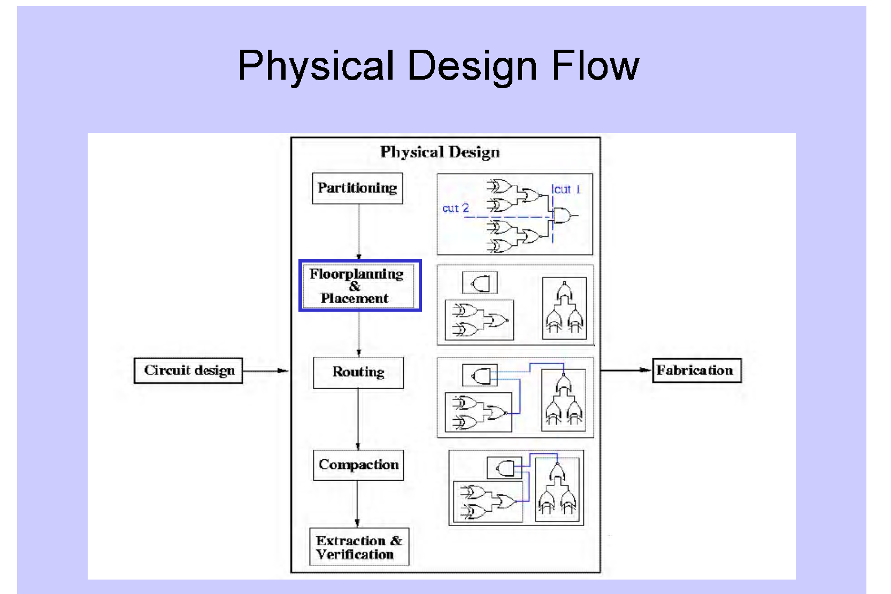

Slide 3
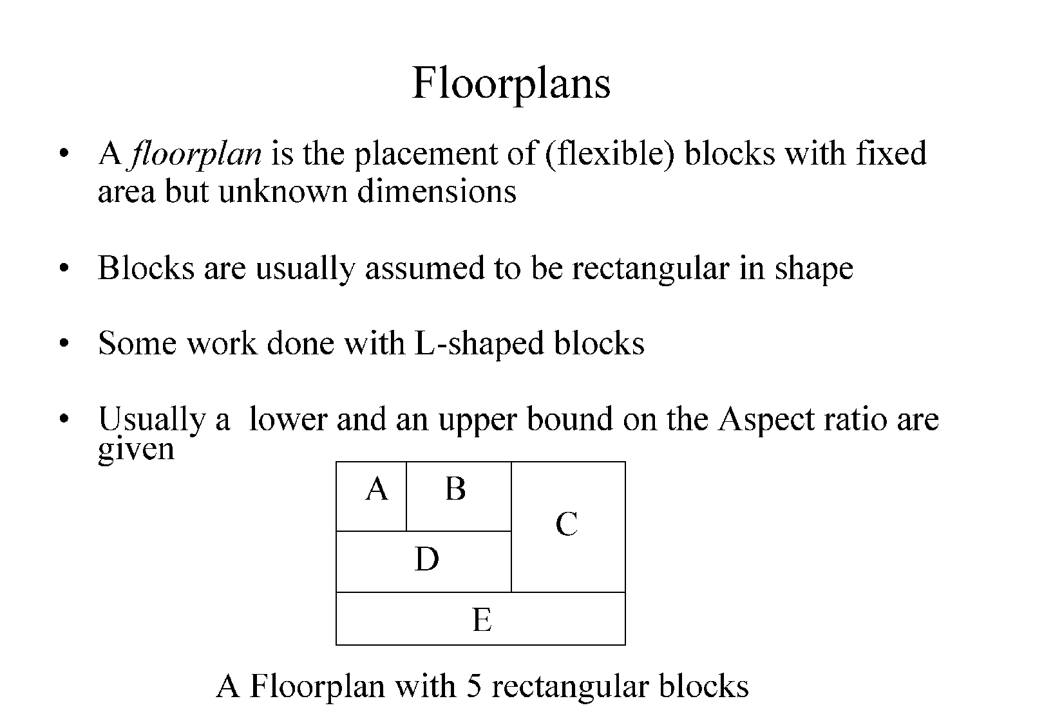
A floorplan is usually represented by a rectangular dissection

Slide 4
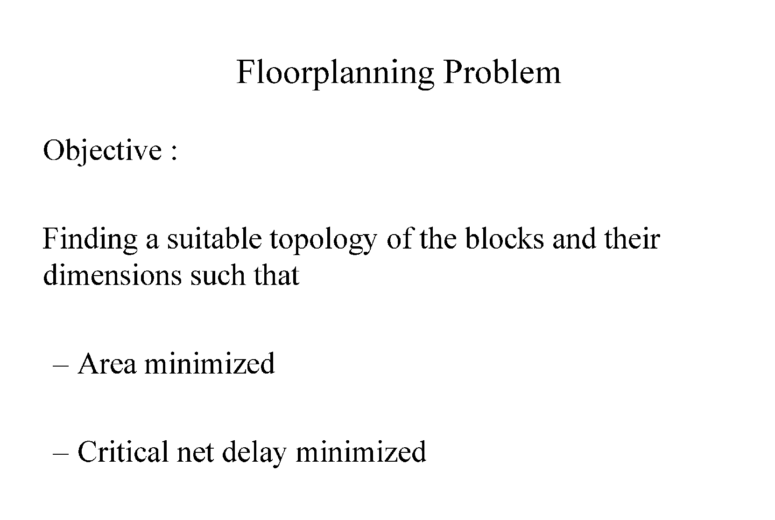

Slide 5
Floorplanning algorithm
A good Floorplanning algorithm should
- minimize total chip area
- make the subsequent routing phase easy
- improve the performance, by, for example, reducing signal delays
It is difficult to
- consider all these goals simultaneously, as they mutually conflict
- consider algorithmically several objectives simultaneously

Slide 6
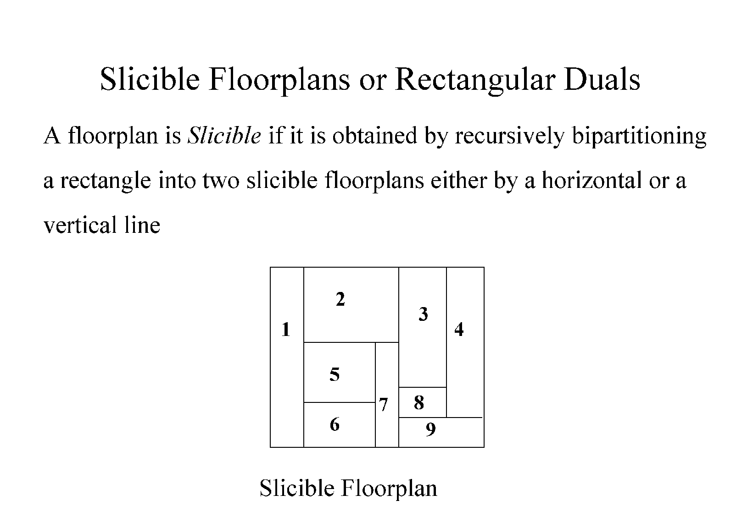

Slide 7
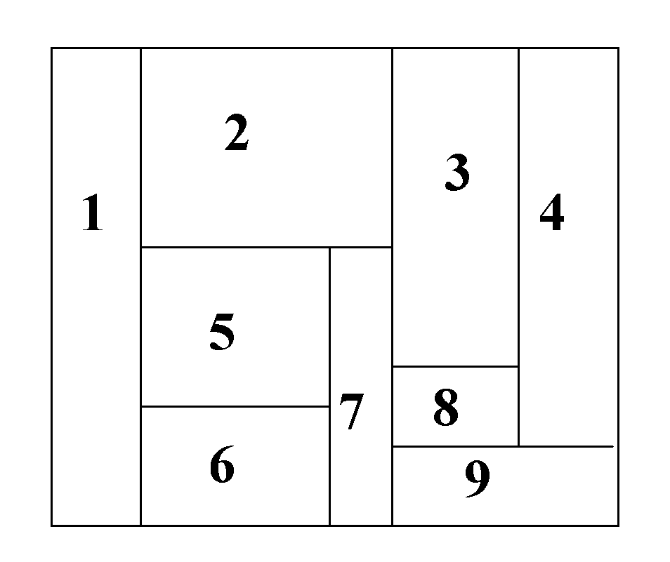
Sliceable Floorplans
123456789
12567
3489
1
2567
348
9
567
2
38
4
56
7
3
8
5
6
Easy to represent with binary tree
- facilitates efficient algorithm design
Sizing and routing algorithms execute in polynomial time

Slide 8
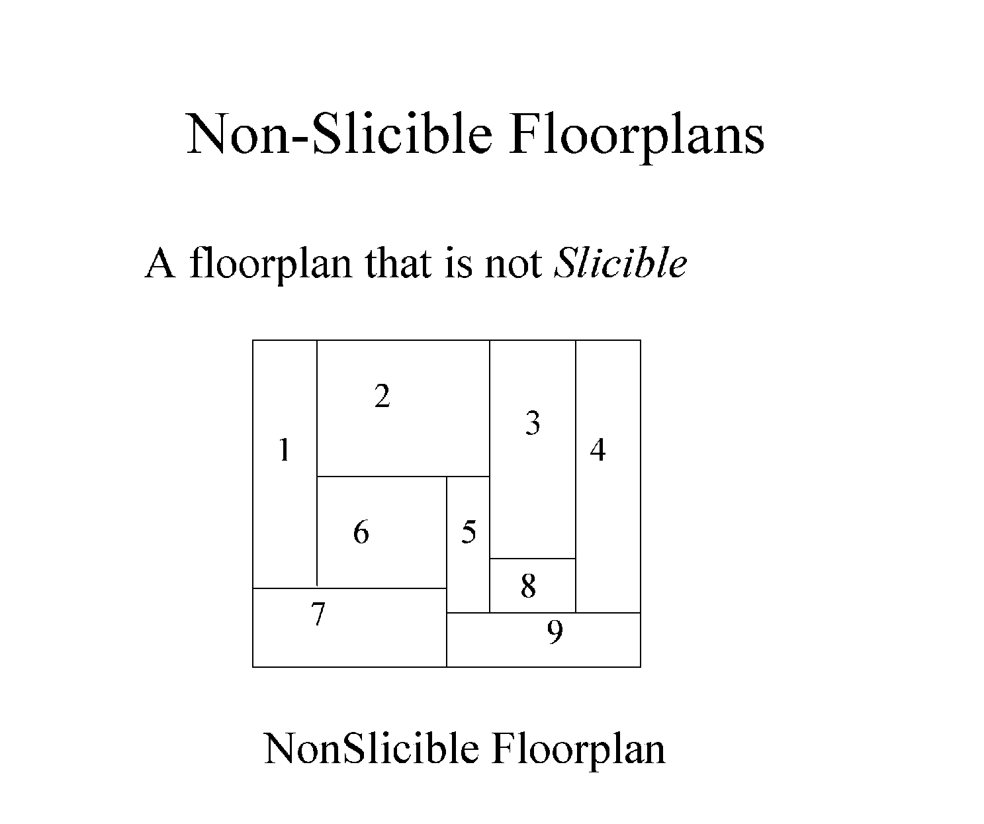
Floorplan sizing problem for nonslicible floorplan is NP complete

Slide 9
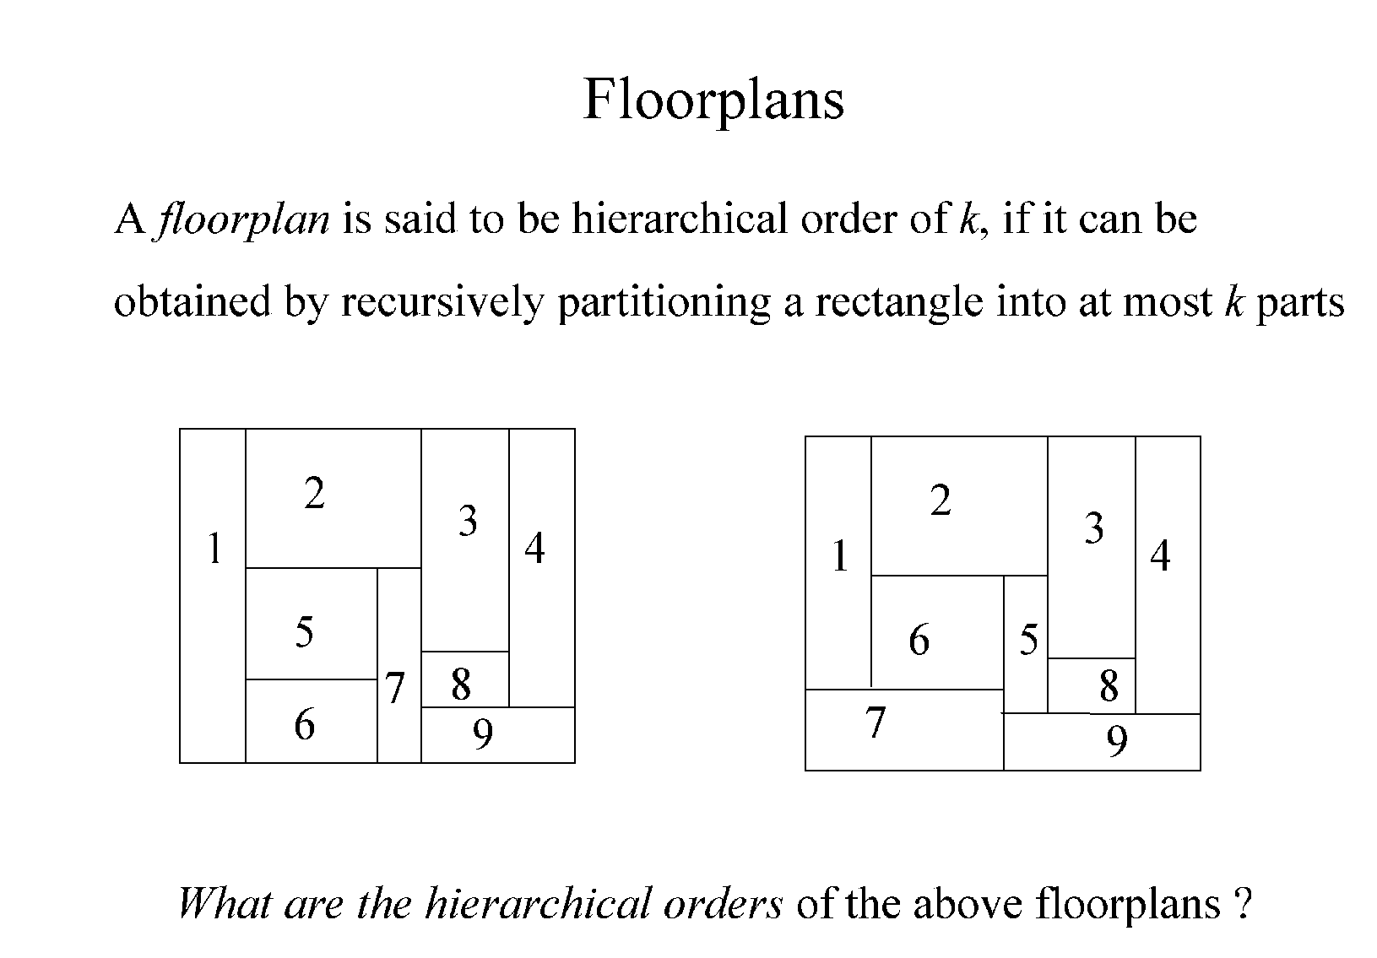

Slide 10
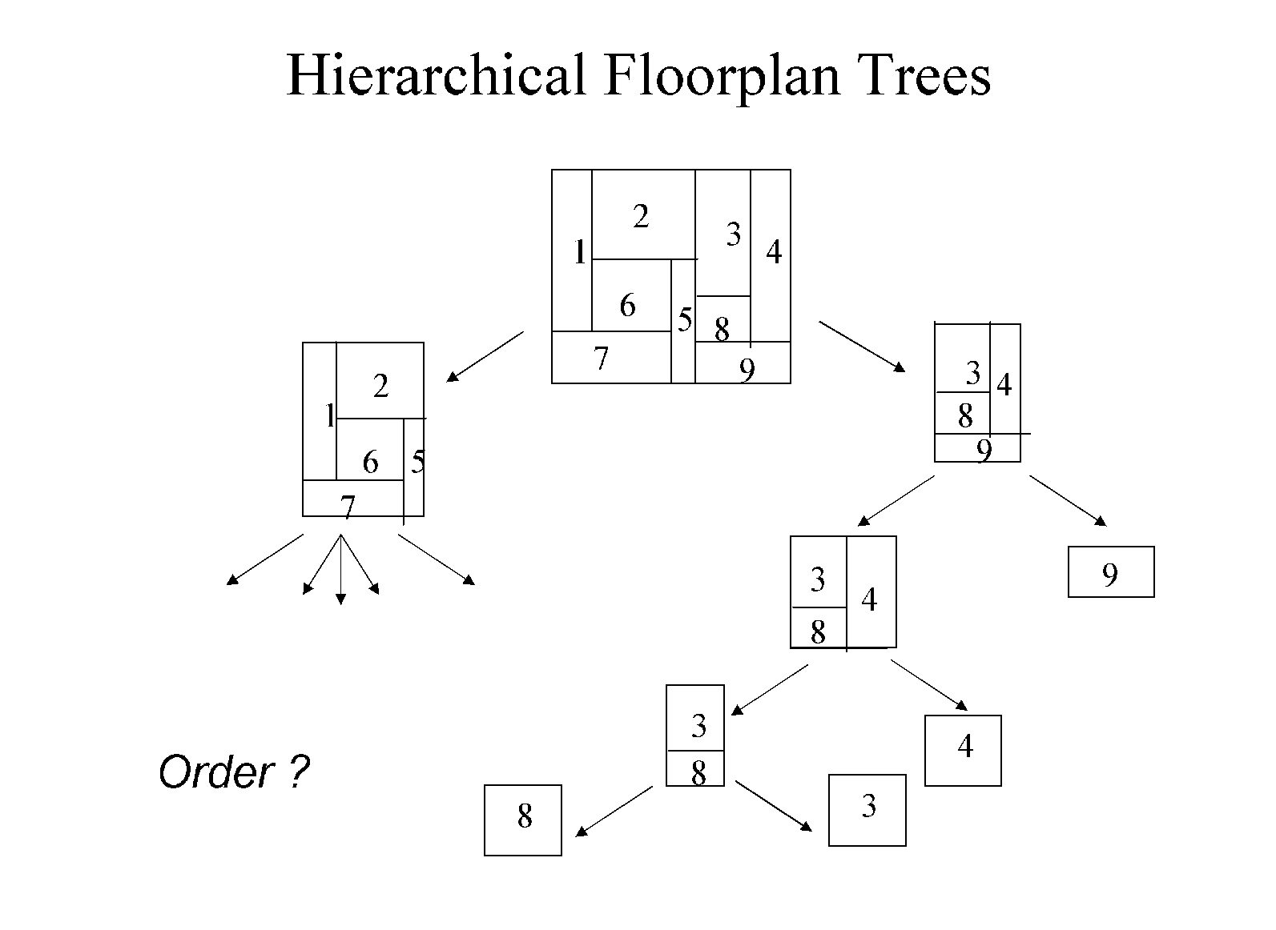
Hierarchially defined floorplan is a floorplan that can be described by a floorplan tree

Slide 11
The leaves of the tree correspond to modules
An internal node defines how its child floorplans are combined to form a partial floorplan
Various restrictions may be imposed on internal nodes
The number of child floorplans cannot exceed a certain limit
The shape of the floorplan corresponding to internal node is limited, for example, to rectangles or other simple shapes

Slide 12
Hierarchical Floorplan
Four types of Internal nodes

Slide 13
1
2
5
6
7
Floorplan sizing problem for nonsliceable floorplan is NP complete

Slide 14
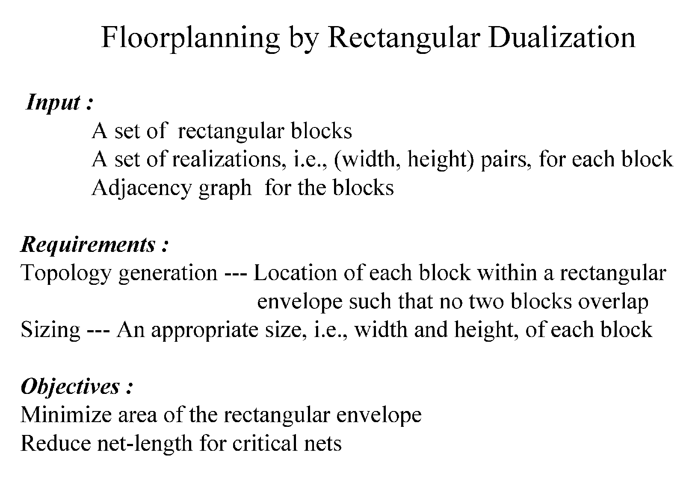

Slide 15
Rectangular Dual Graph
1
2
1
2
3
4
3
5
5
4
A rectangular dual graph of a rectangular floorplan is a plane graph G=(V,E), where V is the set of modules and (M_{i}, M_{j}) ε E if and only if modules M_{i} and M_{j} are adjacent in the floorplan.

Slide 16
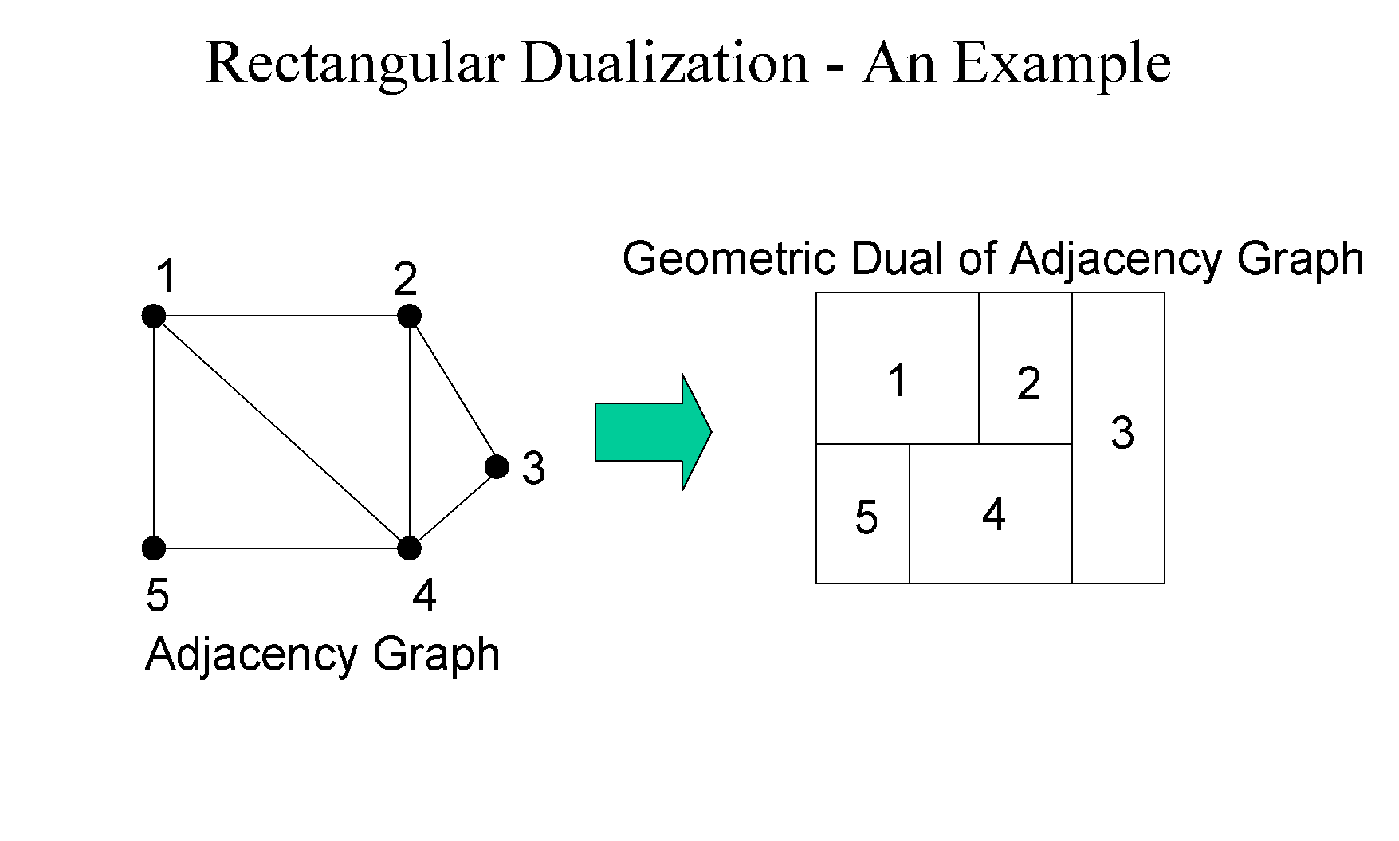

Slide 17
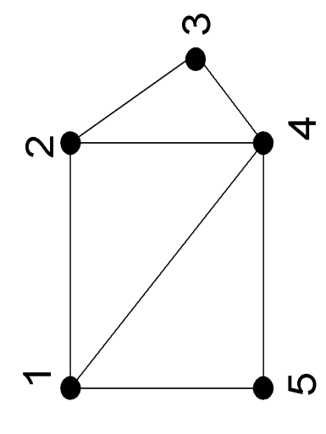
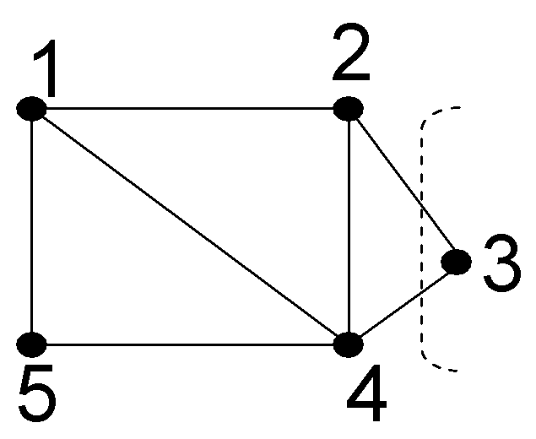
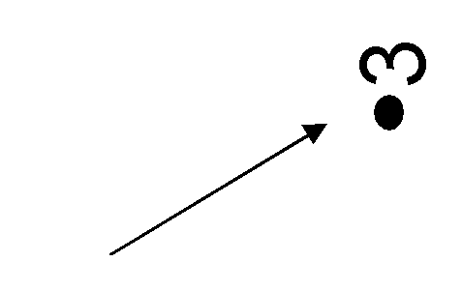
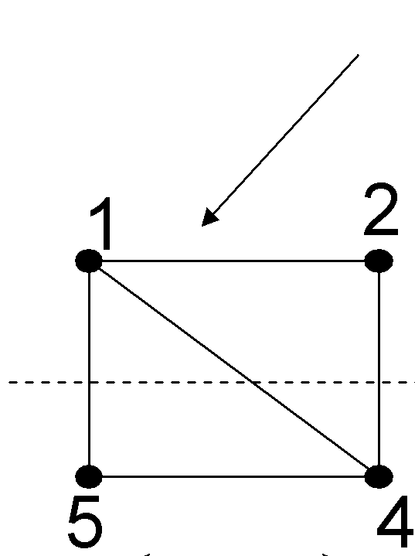
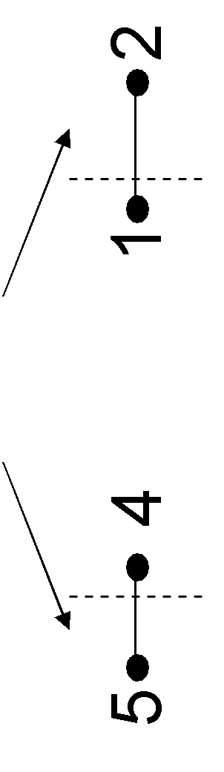
Topology Generation : A simple example
12345
1245
3
12
3
54
1
2
3
5
4

Slide 18
Rectangular Dual
Assumed that a rectangular floorplan contains no cross junctions
A cross junction is replaced by two T-junctions with another short edge
A graph is said to be planar if there exists some geometric representation of G which can be drawn on a plane such that no two of its edges intersect
Dual graph of a rectangular floorplan is a planar triangulated graph (PTG)

Slide 19
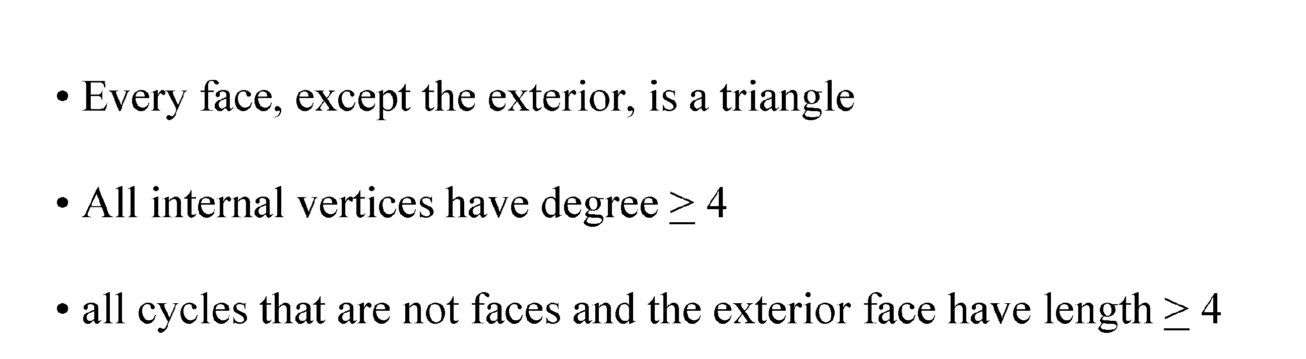
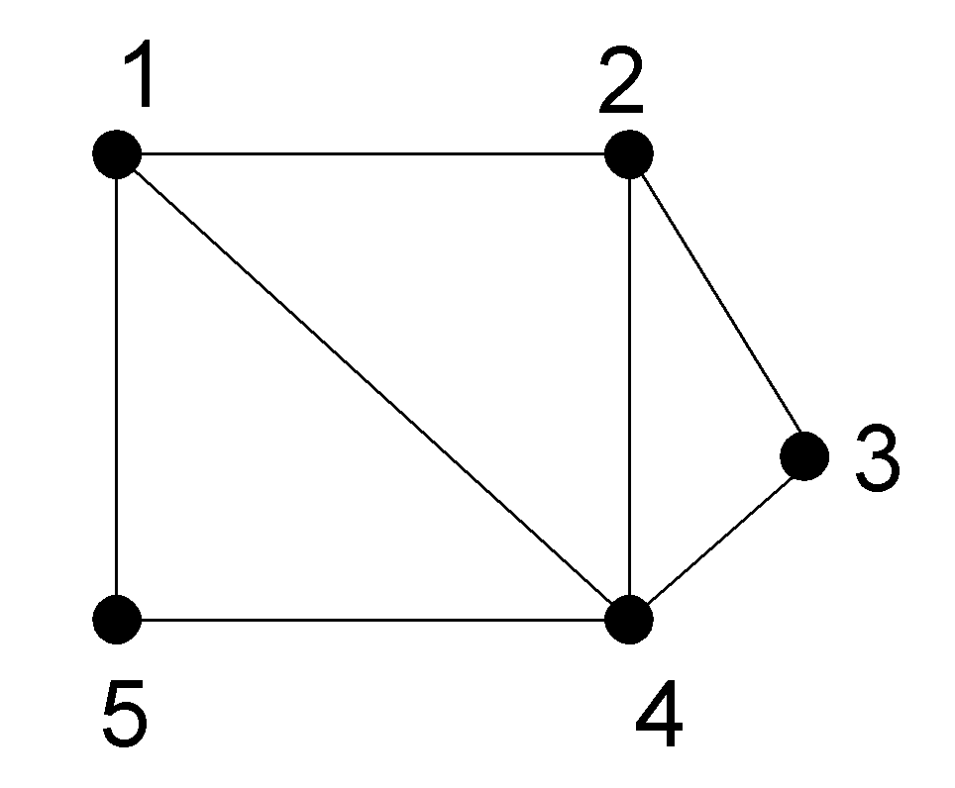
Rectangular Dualization: Planar Triangulated Graph
Dual graph of a rectangular floorplan is a planar triangulated graph (PTG)
1
2
3
5
4

Slide 20
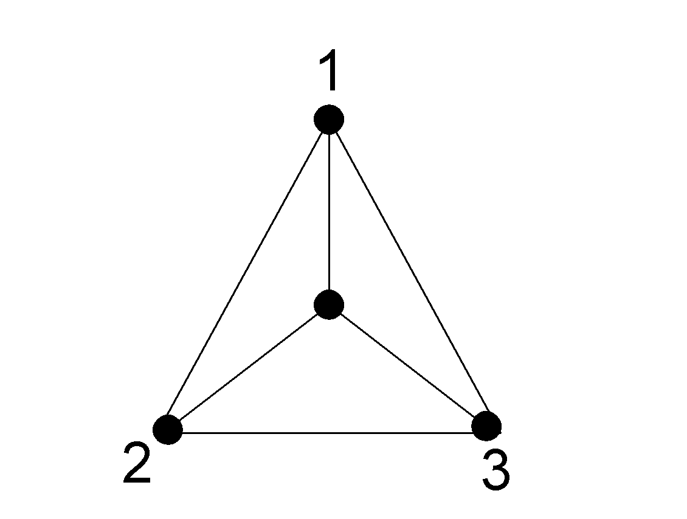

Rectangular Dualization: Planar Triangulated Graph
No corresponding rectangular floorplan exist
Only
Forbidden pattern in rectangular dual graph
Every dual graph of a rectangular floorplan is a planar triangulated graph (PTG)
BUT not every PTG corresponds to a rectangular floorplan
A rectangular floorplan exists iff the dual of the floorplan contains no complex triangle

Slide 21
Extended Dual
u
u
l
F
r
l
G_{e}(n)
r
b
b
A rectangular floorplan exists if and only if the extended dual of the floorplan contains no complex triangles
Hypothesis: It is possible to generate a floorplan for any dual graph G_{e}(k) for k < n

Slide 22
Extended Dual
u
u
v
l
r
l
F (n-1)
v
r
Assume, r has degree 3
b
b
G_{e}(n)
u
u
l
r
l
F (n-1)
r
b
b
G_{e}(n)

Slide 23
u
Dual Decomposition
A path P_{V} = {u=p₁, p₂,…..,p_{m}=b}
(i) p₂,…..,p_{m-1} ∉ {r,u,l,b}
(ii) (p_{i},p_{j}) ∉ G_{e}(n) for all distinct i,j
(iii) (p_{i},l) ∉ G_{e}(n) for some i
(iv) (p_{j},r) ∉ G_{e}(n) for some j
p_{i}
l
p_{j}
r
p_{k}
b
G_{e}(n)
Splitting path
u
u
p_{i}
p_{i}
l
p_{j}
r’
l’
p_{j}
r
p_{k}
p_{k}
G_{el}
b
G_{er}
b

Slide 24
Dual Decomposition
u
u
p_{i}
p_{i}
l
p_{j}
r’
l’
p_{j}
r
p_{k}
p_{k}
G_{el}
b
G_{er}
b
u
u
p_{i}
p_{i}
l
F_{l}
p_{j}
r’
l’
p_{j}
F_{r}
r
p_{k}
p_{k}
b
b

Slide 25
Merging Floorplans
u
u
p_{i}
p_{i}
l
F_{l}
p_{j}
r’
l’
p_{j}
F_{r}
r
p_{k}
p_{k}
b
b
u
p_{i}
l
F
p_{j}
r
p_{k}
b
It is possible to generate a floorplan for any extended dual graph provided it contains no complex triangle

Slide 26
Hierarchical Floorplan
Four types of Internal nodes

Slide 27
Hierarchichal Approach
a
a
b
c
c
b
a
c
b
a
c
b
The number of possible floorplans increases exponentially with number of modules
d =2
d =3

